Slide 1
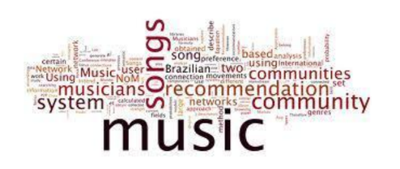
Music Recommendation System
By :
Team 2 September 2022 Batch

Slide 2
Introduction
Task
Objective
Tools
& Technologies
Visualisation
Architecture
Work Flow
Agenda
GUI

Slide 3
Task
Music RecommendationSystem
User‘s listening history &music information
Prediction of similar songs that user will listen to

Slide 4
Introduction
A Music Recommendation System is a technology that analyzes user data such as listening history, search queries, and playlists to provide personalized music recommendations. The system uses Machine Learning algorithms to learn user preferences and create personalized music recommendations that are likely to be of interest to the user.
The Music Recommendation System typically involves the following steps: Data collection, Data preprocessing, Feature extraction, Model training, and Recommendation generation.

Slide 5
Steps
The system collects data from various sources, such as listening history, user profiles and playlists.
Then, the data is preprocessed to remove any noise or irrelevant information.
The system extract features from the preprocessed data to create a representation of the music and the user preferences.
The model is trained on this feature set using machine learning algorithms, such as collaborative filtering or content-based filtering.
Finally, the system generates personalized music recommendations based on the user's preferences and listening history.

Slide 6
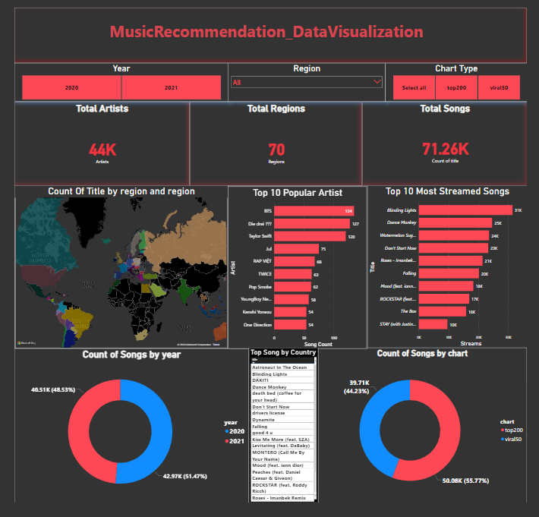
Visualisation (To understand data)

Slide 7

Objective
Deep dive into the usage of Spark, Power BI, Python and Machine learning.
By using technologies such as Spark, Power BI, Python and Machine learning, to develop a highly effective music recommendation system.
Power BI : using Power BI to provide insightful and intuitive visualizations of the data and recommendations generated by the system.
Spark : utilizes the distributed computing framework of Spark to develop a highly scalable recommendation system that can handle large datasets and provide fast, accurate recommendations to users.
Machine Learning : using advanced machine learning techniques in Python to improve the accuracy and personalization of the recommendations provided to users

Slide 8
Tools and Technologies
Spark
Python
Power BI
Machine Learning

Slide 9
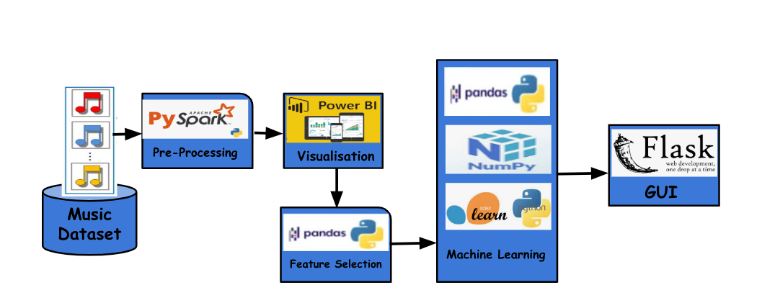
Architecture

Slide 10
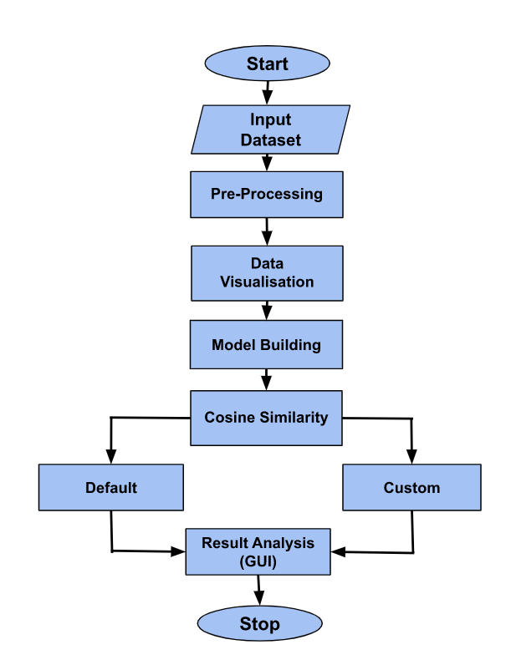
Work Flow

Slide 11
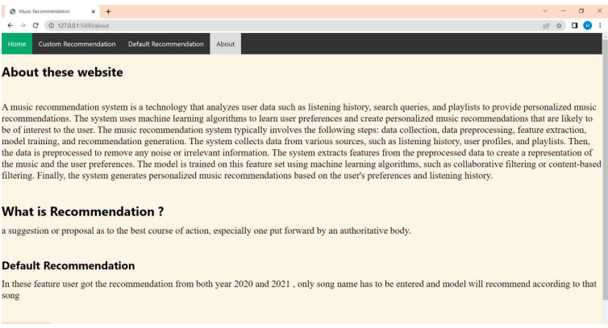
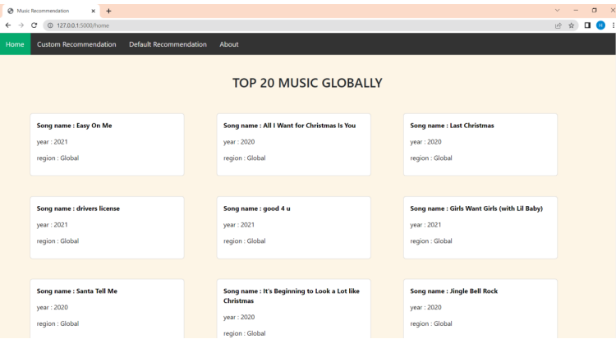
Output Visualisation (GUI):

Slide 12
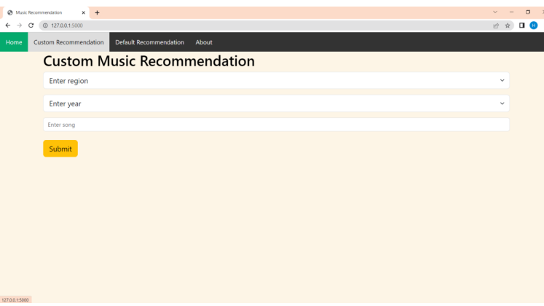
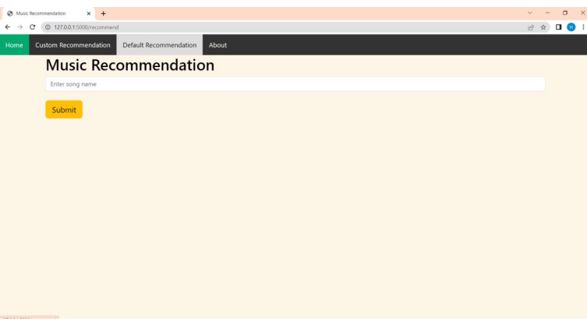
Output Visualisation (GUI):

